Slide 1



ALAYO FAMILY
JULY FASTING & PRAYER MEETING
05 : 00 PM
10 : 00 PM
10 : 00 PM

Slide 2

TOPIC:
WORSHIP REDEFINED: SPIRIT AND TRUTH
John 4:23-24
Ministering: Olakunle Joshua

Slide 3
John 4:23
But the hour cometh, and now is, when the true worshippers shall worship the Father in spirit and in truth: for the Father seeketh such to worship him.
But a time is coming and is already here when the true worshipers will worship the Father in spirit [from the heart, the inner self] and in truth; for the Father seeks such people to be His worshipers.
King James Version
Amplified Bible

Slide 4
John 4:24
God is a Spirit: and they that worship him must worship him in spirit and in truth.
God is spirit [the Source of life, yet invisible to mankind], and those who worship Him must worship in spirit and truth.
King James Version
Amplified Bible

Slide 5
Background Information
Jesus travels from Judea to Galilee, passing though Samaria.
Jesus comes to a well in Sychar of Samaria.
Jesus speaks with a Samaritan woman.
Jesus interests the woman in living water.
Jesus describes the effect of the living water He offers.
Jesus describes the effect of the living water He offers.
Jesus speaks of her sinful life.

Slide 6
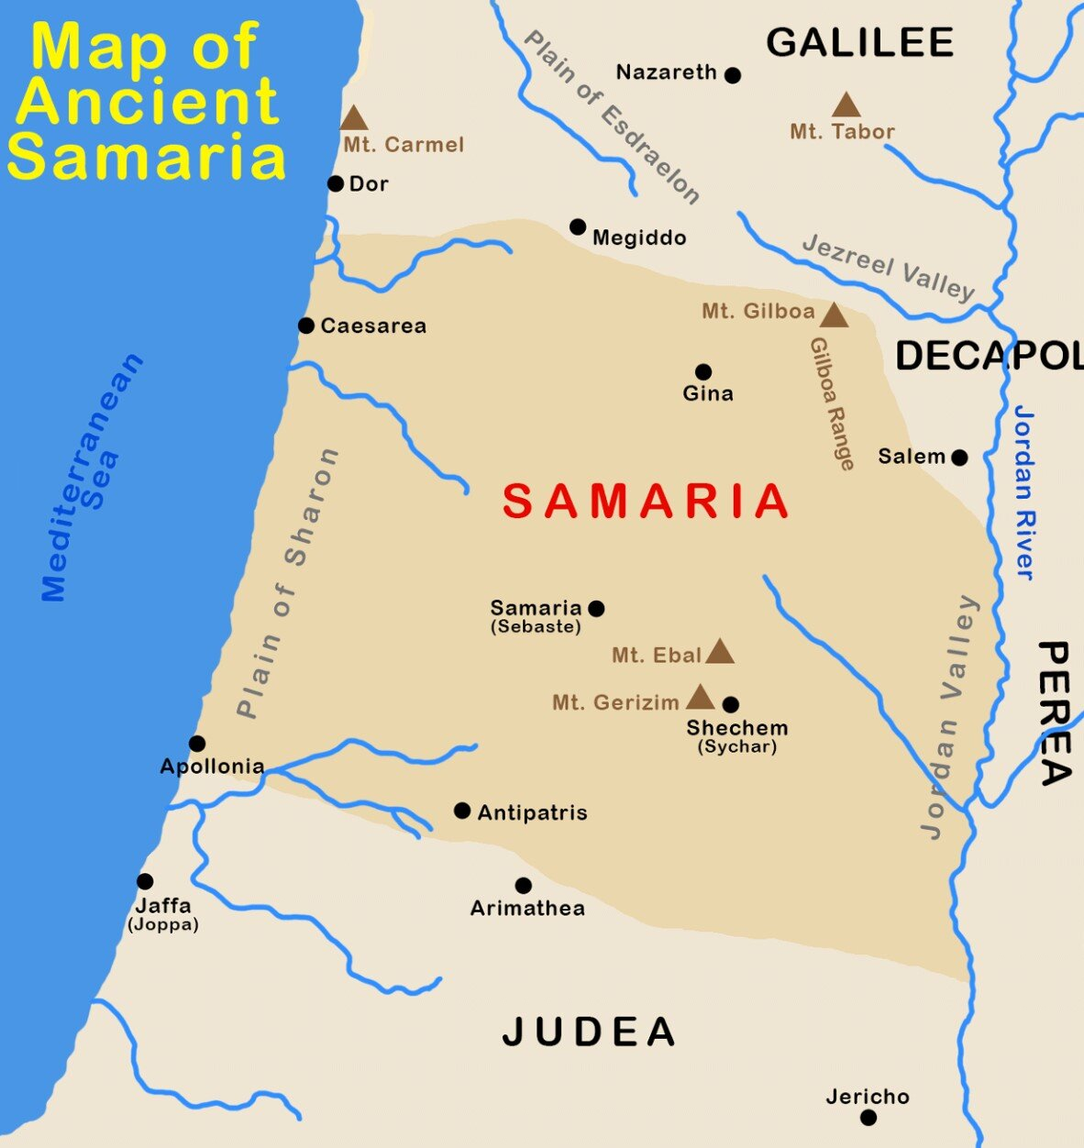

Jesus travels from Judea to Galilee, passing though Samaria.
Deep distrust and dislike between many of the Jewish people and the Samaritans make them takes a different route. They go through Jordan.
No, He didn’t go with a car. No wonder he got tired and needed to drink some water. He left because his popularity and prominence is a threat to the religious establishment (among whom where the Pharisees)

Slide 7

“People are thirsty – they want, they long, they search, they reach; but only what Jesus gives satisfies to the deepest levels of man’s soul and spirit”.
Jesus is a good communicator. He spoke about the water and the Samaritan woman was convinced and yarn to taste and get such water.

Slide 8
“Christ has different doors for entering into different people’s souls. Into some, he enters by the understanding; into many, by the affections. To some, he comes by the way of fear; to another, by that of hope; and to this woman he came by way of her conscience.” (Spurgeon)
Sir, I perceive that You are a prophet: This was an obvious observation from the woman. She was no doubt surprised; perhaps stunned that Jesus had supernatural knowledge of her life.

Slide 9
Finally,
The Samaritan woman and Jesus discuss worship.
John 4: 20-26

Slide 10
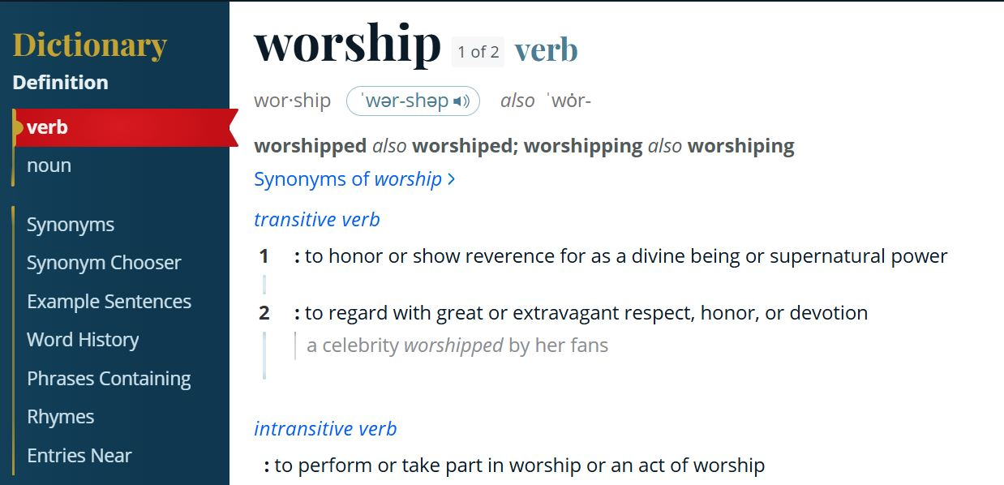

Slide 11
Basis for true worship: SPIRIT & TRUTH
To worship in spirit means you are concerned with spiritual realities, not so much with places or outward sacrifices, cleansings, and trappings.
To worship in truth means you worship according to the whole counsel of God’s word, especially in light of the New Testament revelation. It also means that you come to God in truth, not in pretense or a mere display of spirituality.

Slide 12

What worship is NOT
Worship is not self-centered, but God-centered.
Worship is not about merely “going to church”.
Worship is not based on what you like, but on Who you love.
Worship is not about the set up, the instruments, or the traditions.
Worship is not an emotional escape.

Slide 13
John 4:23
But a time is coming and is already here when the true worshipers will worship the Father in spirit [from the heart, the inner self] and in truth; for the Father seeks such people to be His worshipers.

Slide 14

Will the Father find you fit enough for His worship?
olakunle437@gmail.com

